Slide 1
NEURAL NETWORK

Slide 2








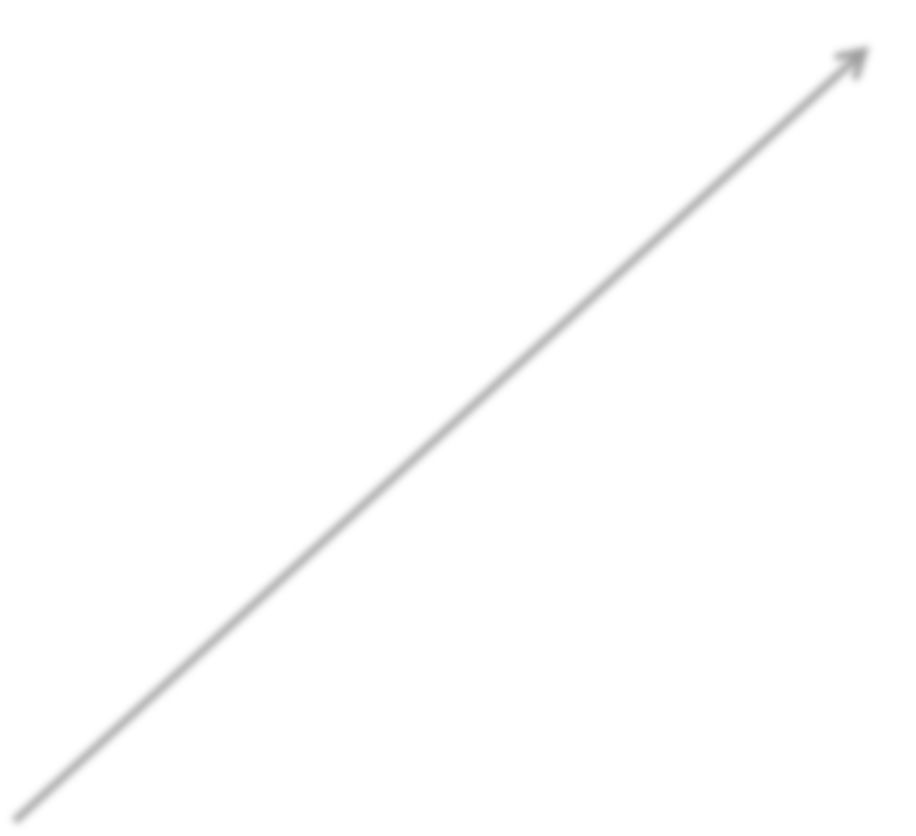
























Input value 1
Input value 2
Output value
Input value 3
Input Layer
Hidden Layer
Output Layer

Slide 3



















Input Layer
Output Layer

Slide 4










































































































































































Input Layer
Hidden Layers
Output Layer

Slide 6


Supervised
Artificial Neural Networks
Used for Regression & Classification
Convolutional Neural Networks
Used for Computer Vision
Recurrent Neural Networks
Used for Time Series Analysis
Unsupervised
Self-Organizing Maps
Used for Feature Detection
Deep Boltzmann Machines
Used for Recommendation Systems
AutoEncoders
Used for Recommendation Systems

Slide 7


Slide 8




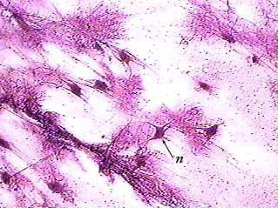
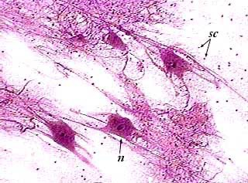
Image Source: www.austincc.edu

Slide 9
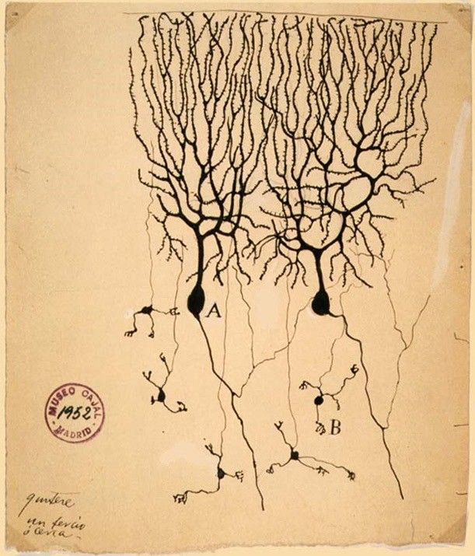
Image Source: Wikipedia

Slide 10




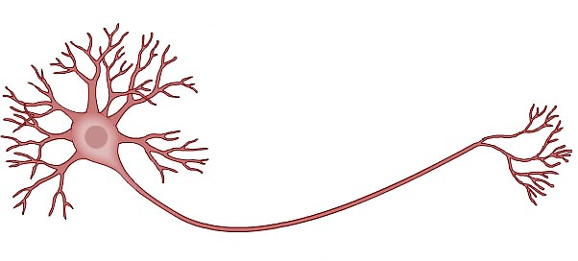







Dendrites
Axon
Neuron
Image Source: Wikipedia

Slide 11






Node
neuron

Slide 12





neuron
Input signal 1
Input signal 2
Input signal m

Slide 13

neuron
Input signal 1
Input signal 2
Output signal
Input signal m

Slide 14














neuron
Input value 1
X1
Input value 2
X2
Output signal
Input value m
Xm
Synapse

Slide 15


neuron
Input value 1
X1
Input value 2
X2
y
Output value
Input value m
Xm
Synapse

Slide 16




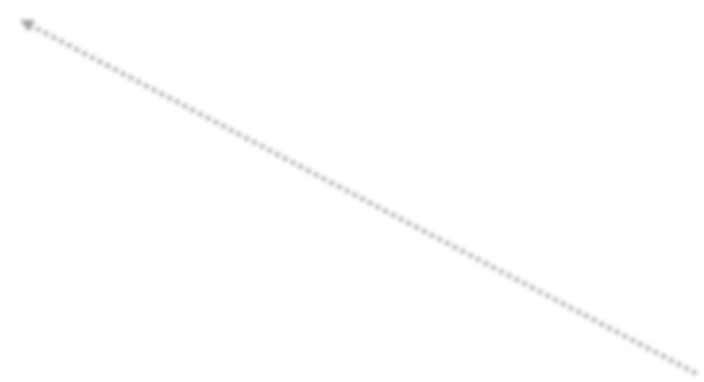





Input value 1
Independent variable 1
X1
Input value 2
Independent variable 2
X2
neuron
y
Output value
Input value m
Independent variable m
Xm
Standardize

Slide 17

Input value 1
Independent variable 1
X1
Input value 2
Independent variable 2
X2
neuron
y
Output value
Can be:
Continuous (price)
Binary (will exit yes/no)
Categorical
Input value m
Independent variable m
Xm

Slide 18







Input value 1
Independent variable 1
X1
y1
Output value 1
Input value 2
Independent variable 2
X2
neuron
y2
Output value 2
y3
Output value p
Input value m
Independent variable m
Xm

Slide 19
Input value 1
Independent variable 1
X1
Input value 2
Independent variable 2
X2
neuron
y
Output value
Input value m
Independent variable m
Xm
Single Observation
Same observation
Single Observation

Slide 20

w1 w2
wm
Input value 1
X1
Input value 2
X2
neuron
y
Output value
Input value m
Xm

Slide 21



ne?uron
Input value 1
X1
w1
X2
w2
y
Input value 2
Output value
wm
Input value m
Xm

Slide 22
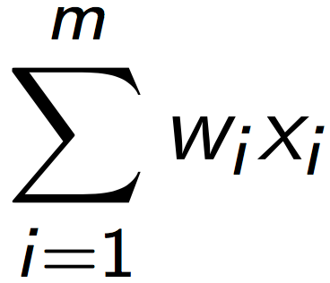
1st step:
Input value 1
X1
w1
X2
w2
y
Input value 2
Output value
wm
Input value m
Xm

Slide 23
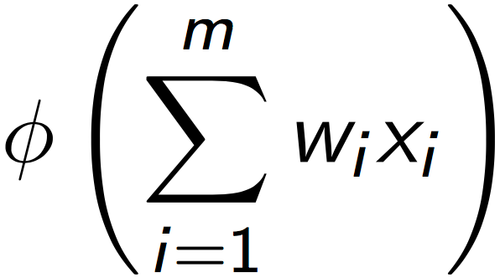
2nd step:
Input value 1
X1
w1
X2
w2
y
Input value 2
Output value
wm
Input value m
Xm

Slide 24

3rd step
Input value 1
X1
w1
2nd step:
X2
w2
y
Input value 2
Output value
wm
Input value m
Xm

Slide 26
3rd step
Input value 1
X1
w1
2nd step:
X2
w2
y
Input value 2
Output value
wm
Input value m
Xm

Slide 27
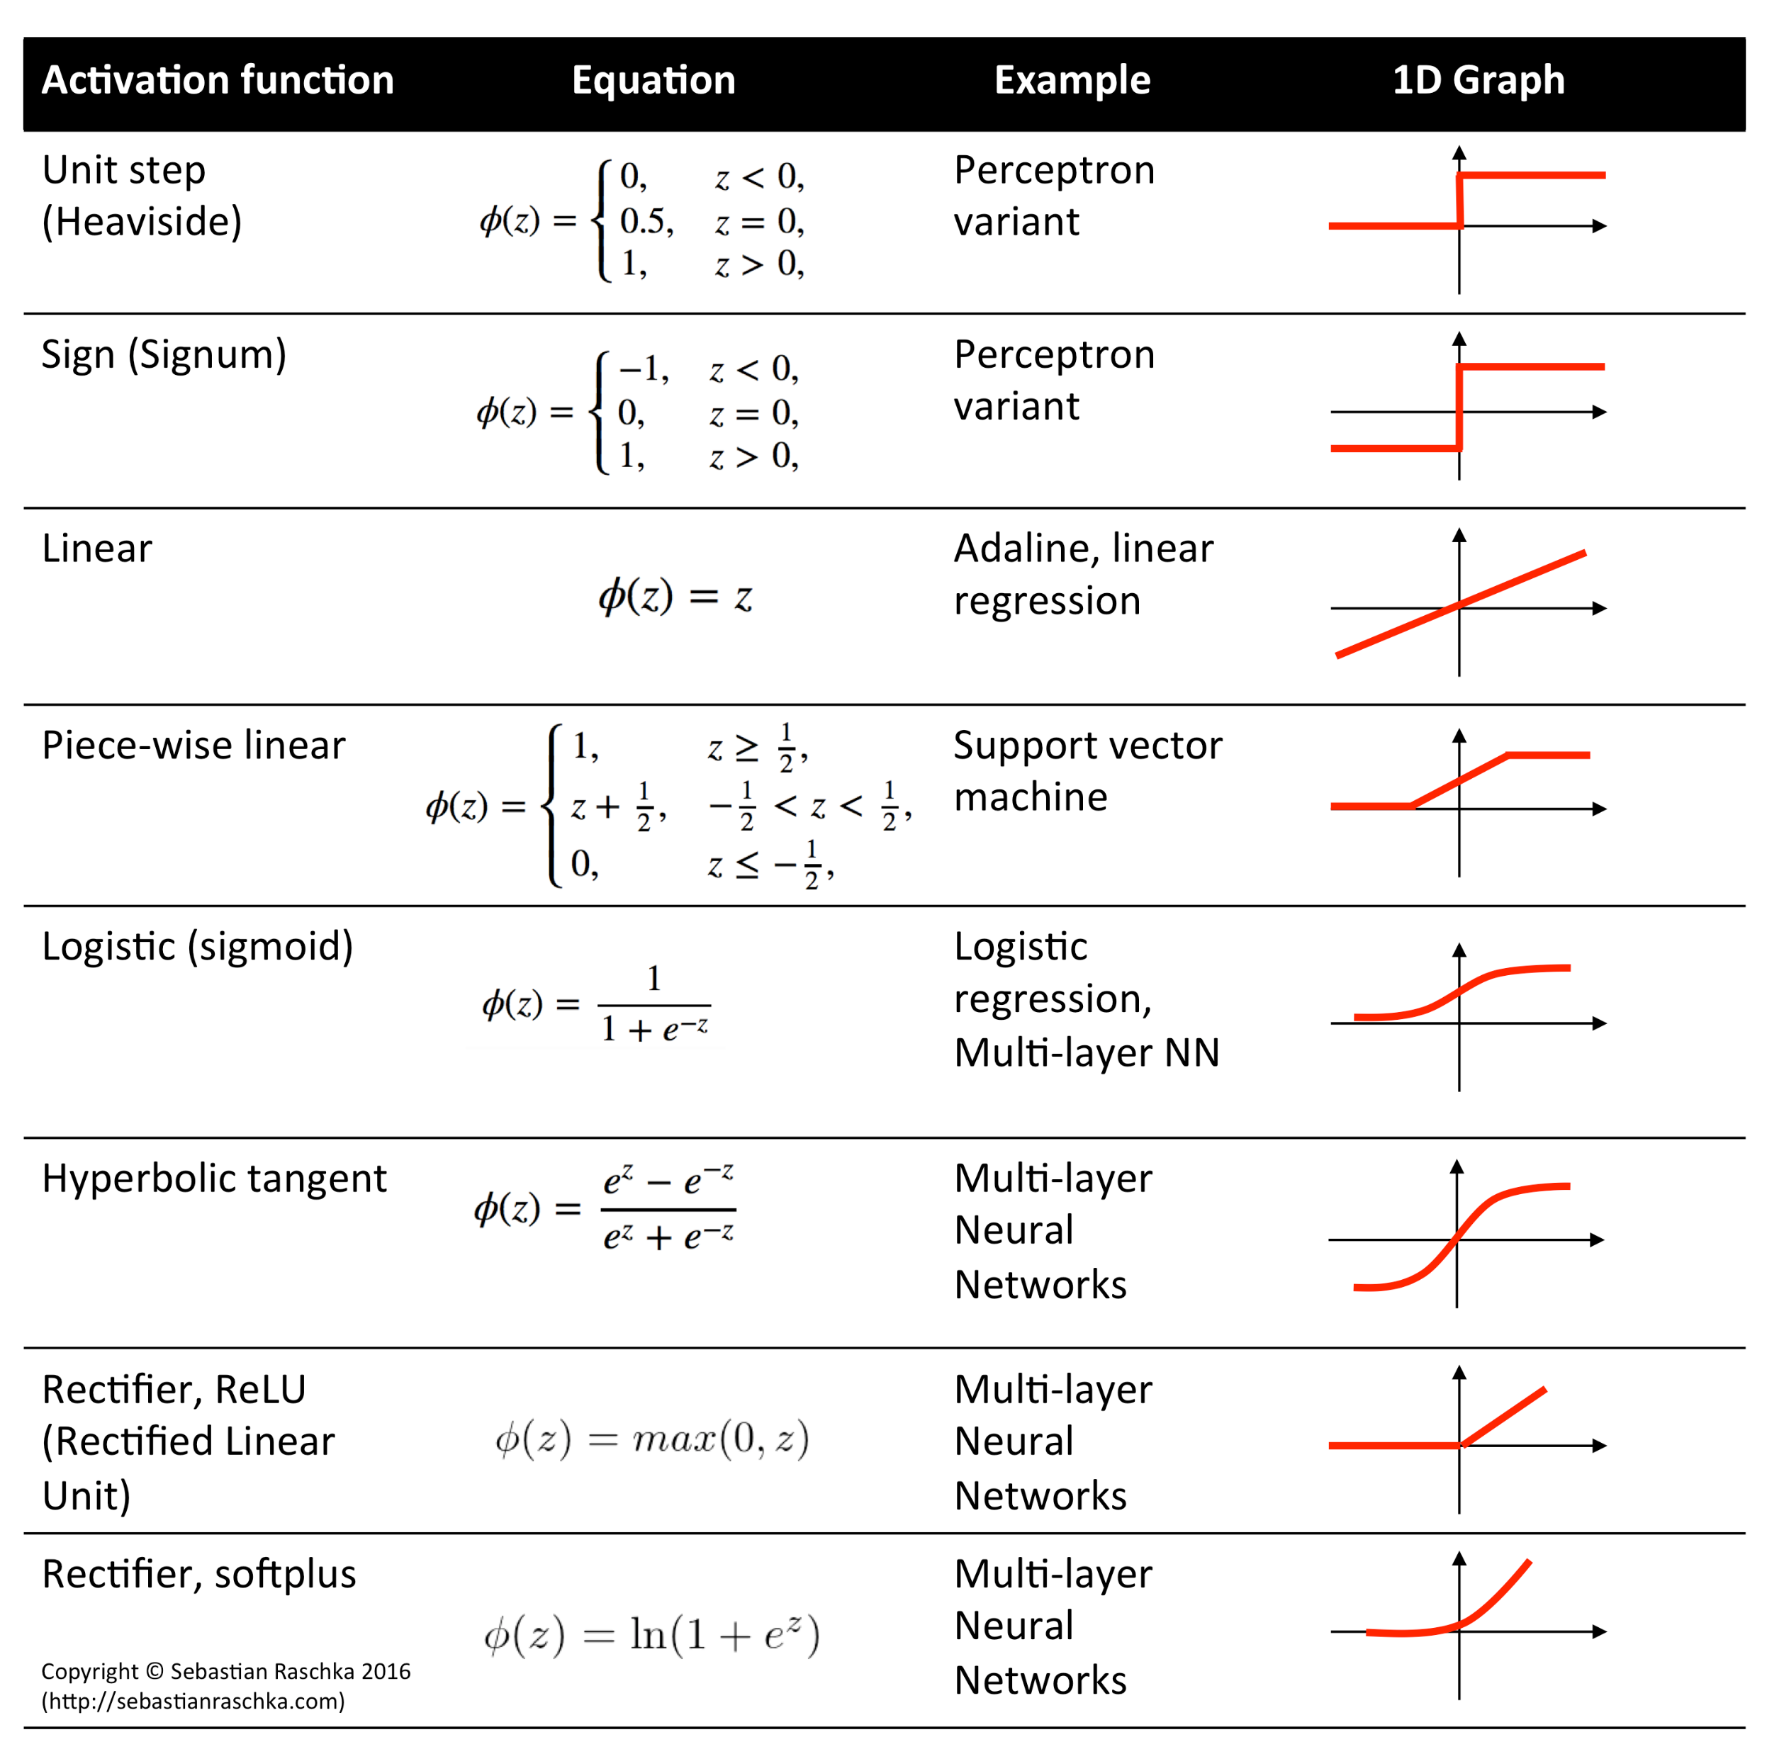
ACTIVATION FUCTIONS
Sigmoid
TanH
ReLu
softmax

Slide 28

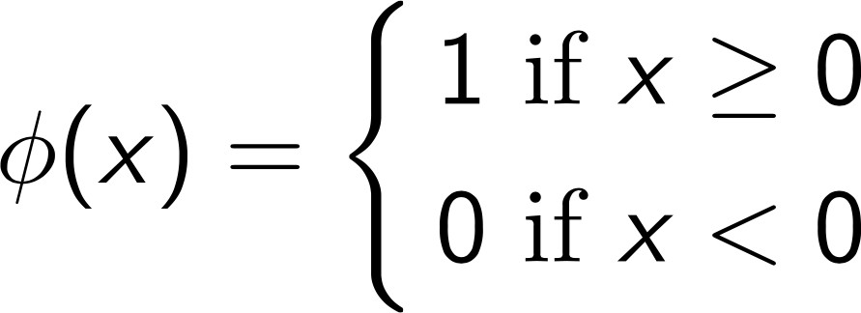

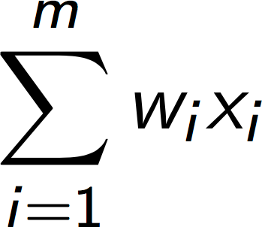
Threshold Function
y
1
0

Slide 29
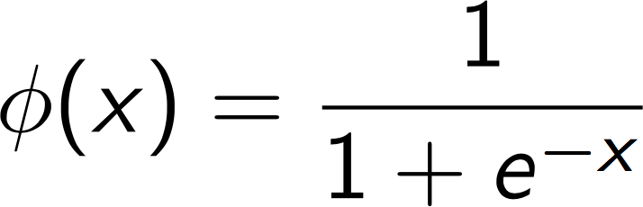
Sigmoid
y
1
0

Slide 30
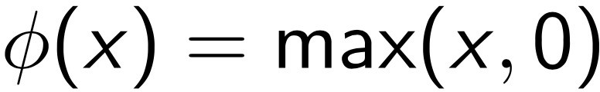

Rectifier
y
1
0

Slide 31

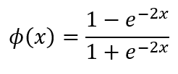
Hyperbolic Tangent (tanh)
y
1
0
-1

Slide 32

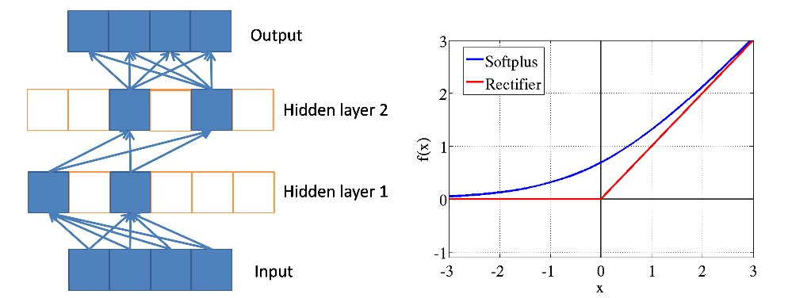
Additional Reading:
Deep sparse rectifier neural networks
By Xavier Glorot et al. (2011)
Link:
http://jmlr.org/proceedings/papers/v15/glorot11a/glorot11a.pdf

Slide 33












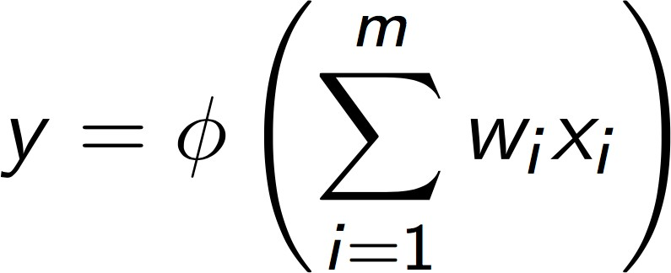


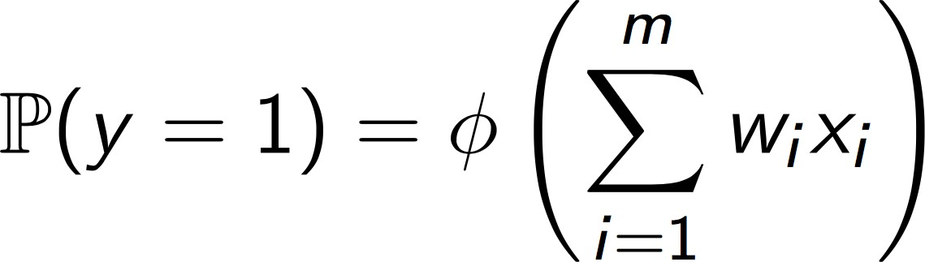
Input value 1
X1
w1
2nd step:
w2
3rd step
Input value 2
X2
y
Output value
wm
Input value m
Xm
If threshold activation function:
Assuming the DV is binary (y = 0 or 1)
If sigmoid activation function:

Slide 34


































Input value 1
X1
Input value 2
X2
Output value
y
Input value m
Xm
Input Layer
Hidden Layer
Output Layer

Slide 35

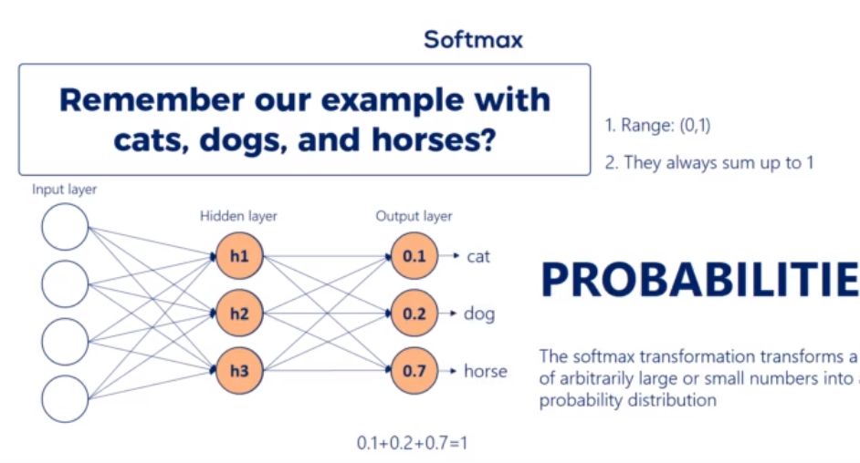
Softmax function

Slide 37


Slide 38

















Area (feet²)
X1
w1
Bedrooms
X2
w2
Price = w1*x1+ w2*x2+ w3*x3+ w4*x4
y
w3
w4
Distance to city (Miles)
X3
Age
X4
Input Layer
Output Layer

Slide 39













Area (feet²)
X1
Bedrooms
X2
y
Distance to city (Miles)
X3
Age
X4
Input Layer
Hidden Layer
Output Layer

Slide 40






Area (feet²)
X1
Bedrooms
X2
y
Distance to city (Miles)
X3
Age
X4
Input Layer
Hidden Layer
Output Layer

Slide 41






Area (feet²)
X1
Bedrooms
X2
y
Distance to city (Miles)
X3
Age
X4
Input Layer
Hidden Layer
Output Layer

Slide 42








Area (feet²)
X1
Bedrooms
X2
y
Distance to city (Miles)
X3
Age
X4
Input Layer
Hidden Layer
Output Layer

Slide 43





Area (feet²)
X1
Bedrooms
X2
y
Distance to city (Miles)
X3
Age
X4
Input Layer
Hidden Layer
Output Layer

Slide 44










Area (feet²)
X1
Bedrooms
X2
y
Distance to city (Miles)
X3
Age
X4
Input Layer
Hidden Layer
Output Layer

Slide 45














Area (feet²)
X1
Bedrooms
X2
y
Distance to city (Miles)
X3
Age
X4
Input Layer
Hidden Layer
Output Layer

Slide 46







Area (feet²)
X1
Bedrooms
X2
y
Distance to city (Miles)
X3
Age
X4
Input Layer
Hidden Layer
Output Layer

Slide 47

Area (feet²)
X1
Bedrooms
X2
y
Price
Distance to city (Miles)
X3
Age
X4
Input Layer
Hidden Layer
Output Layer

Slide 49





Slide 50


Input value 1
X1
w1
X2
w2
ŷy
Input value 2
Output value
wm
Input value m
Xm
y
Actual value

Slide 51




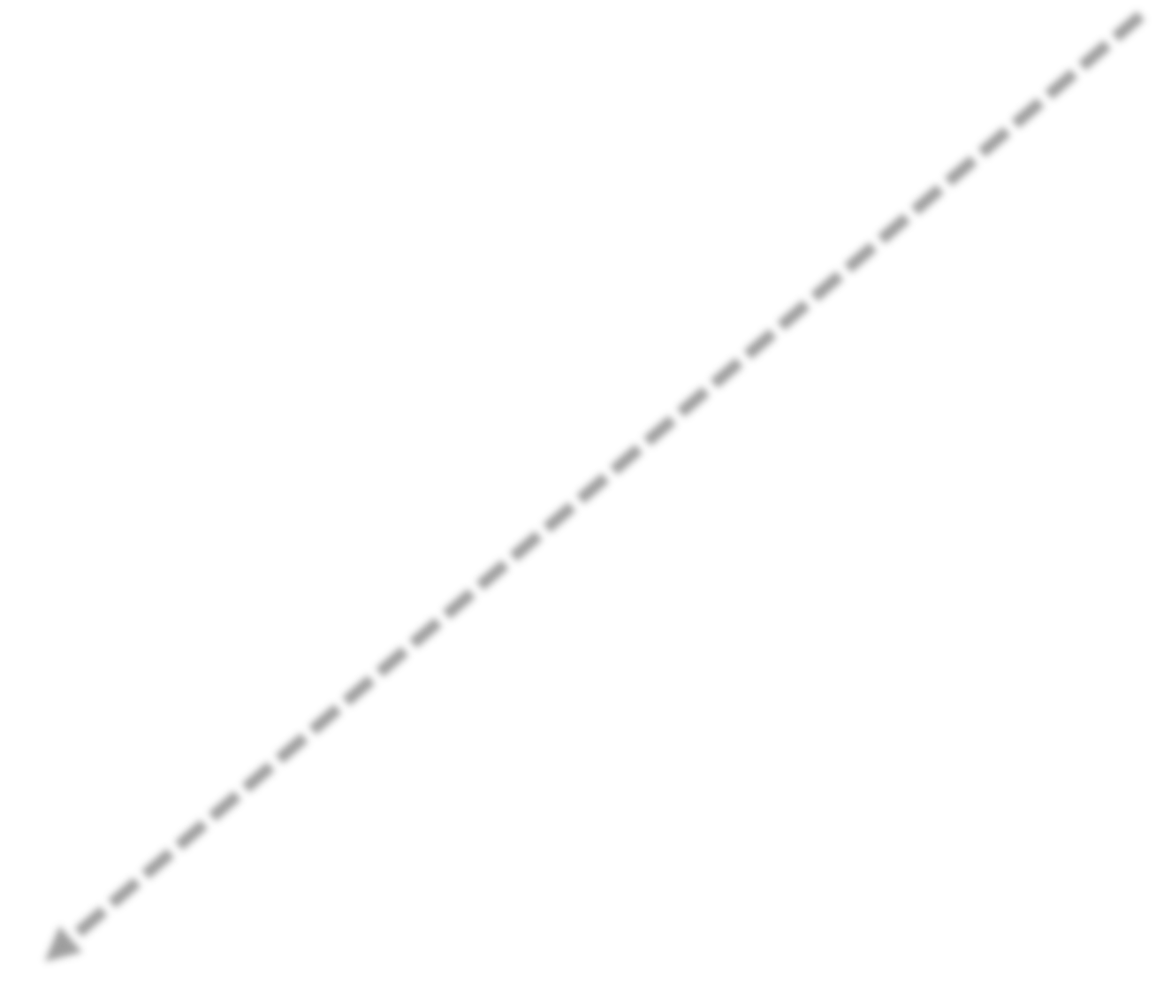
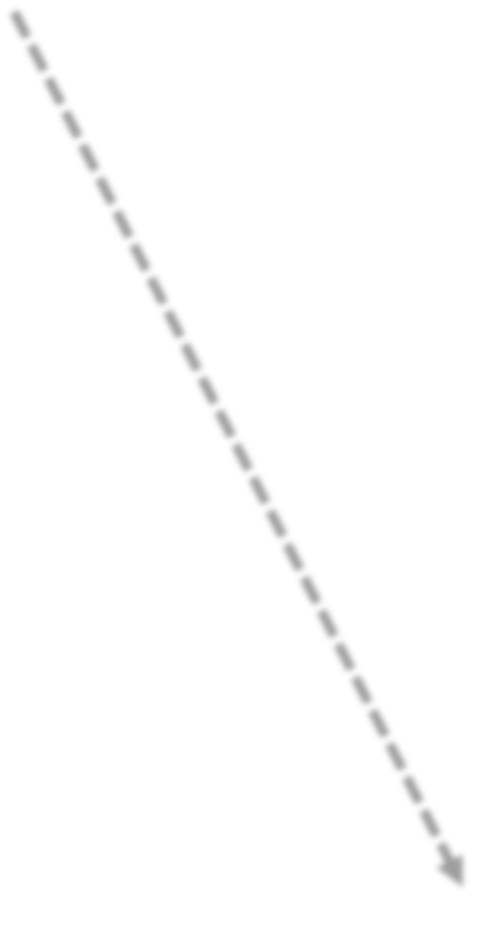
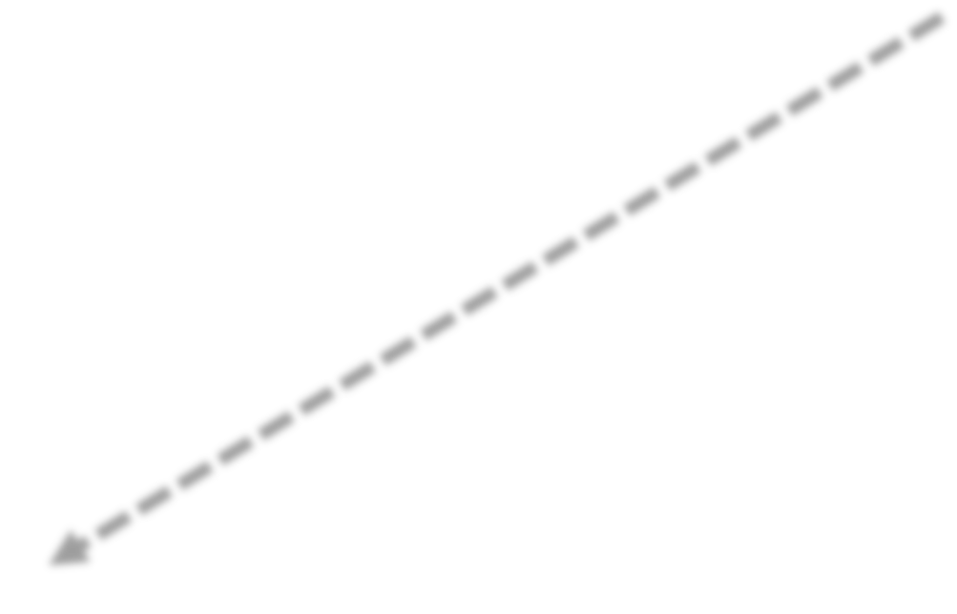




ŷ
y
C
Input value 1
X1
w1
X2
w2
ŷ
Input value 2
Output value
wm
Input value m
Xm
y
Actual value

Slide 52






















ŷ
y
C
Input value 1
X1
w1
X2
w2
ŷ
Input value 2
Output value
C = ½(ŷ- y)²
wm
Input value m
Xm
y
Actual value

Slide 53
ŷ
y
C
Input value 1
X1
w1
X2
w2
ŷ
Input value 2
Output value
C = ½(ŷ- y)²
wm
Input value m
Xm
y
Actual value

Slide 54
ŷ
y
C
Input value 1
X1
w1
X2
w2
ŷ
Input value 2
Output value
C = ½(ŷ- y)²
wm
Input value m
Xm
y
Actual value

Slide 55
ŷ
y
C
Input value 1
X1
w1
X2
w2
ŷ
Input value 2
Output value
C = ½(ŷ- y)²
wm
Input value m
Xm
y
Actual value

Slide 56
ŷ
y
C
Input value 1
X1
w1
X2
w2
ŷ
Input value 2
Output value
C = ½(ŷ- y)²
wm
Input value m
Xm
y
Actual value

Slide 57
ŷ
y
C
Input value 1
X1
w1
X2
w2
ŷ
Input value 2
Output value
C = ½(ŷ- y)²
wm
Input value m
Xm
y
Actual value

Slide 58







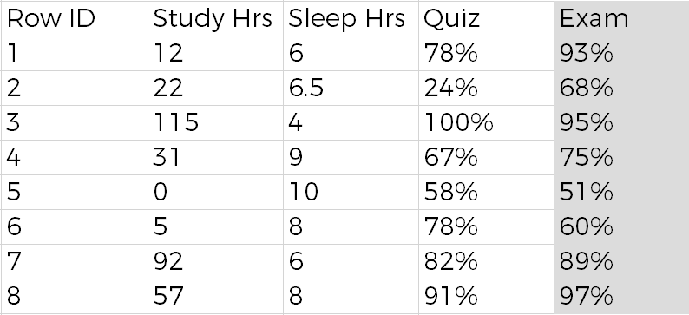












































































































































X1
w1
X1
w1
X2
w2
ŷ
X2
w2
ŷ
Xm
wm
Xm
wm
y
y
X1
w1
X1
w1
C = ∑ ½(ŷ- y)²
X2
w2
ŷ
X2
w2
ŷ
Xm
wm
Xm
wm
y
y
X1
w1
X1
w1
Adjust w₁, w₂, w₃
X2
w2
ŷ
X2
w2
ŷ
Xm
wm
Xm
wm
C
y
y
X1
w1
X1
w1
X2
w2
ŷ
X2
w2
ŷ
ŷ y ŷ y ŷ y ŷ y ŷ y ŷ y ŷ y ŷ y
Xm
wm
Xm
wm
y
y

Slide 59
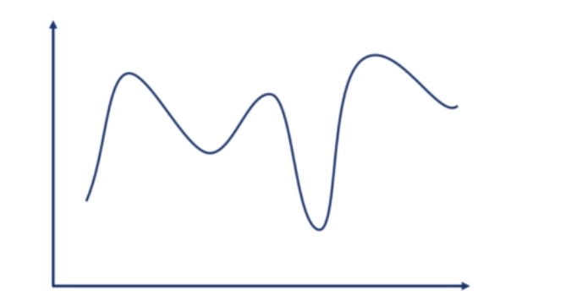
Real life is not linear
Linear + Non Linear

Slide 60
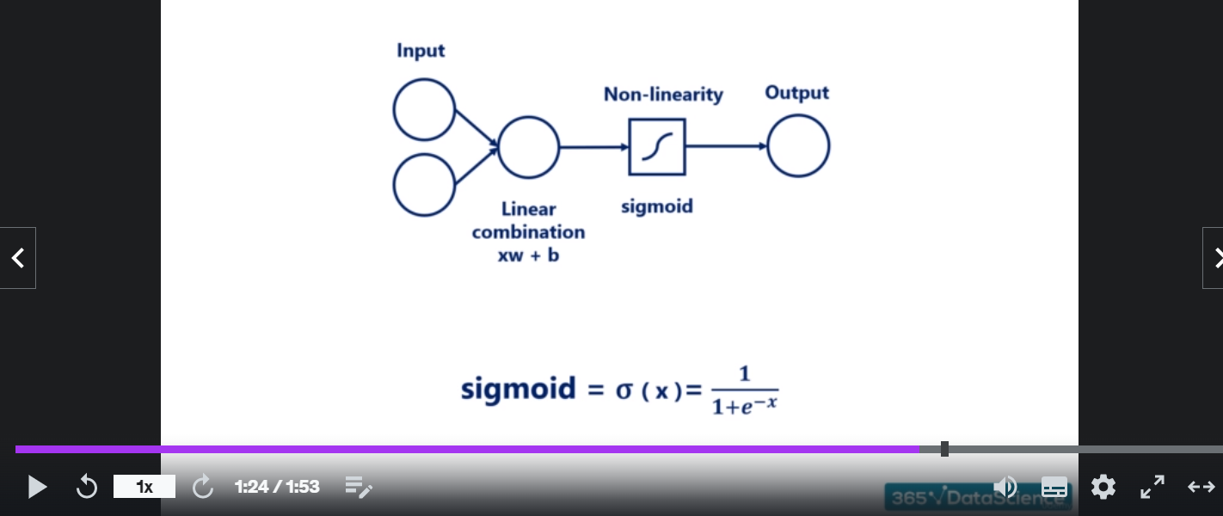
Non Linearity - Layer

Slide 61
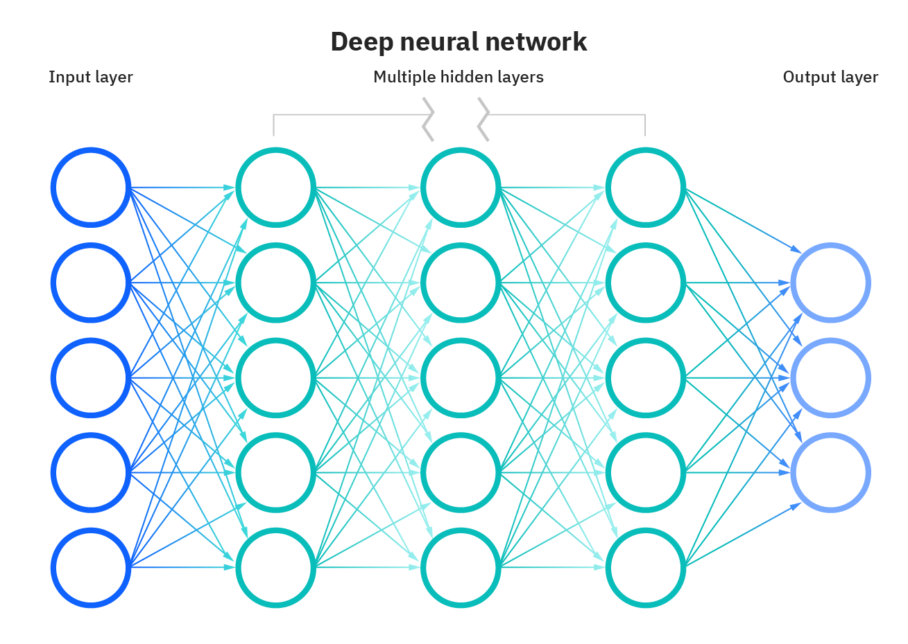
DEEP NEURAL NETWORK

Slide 62
Hyper parameter Vs Parameter
Hyperparameters | Parameters
Width | Weights
Depth | Biases
Learning rate

Slide 63
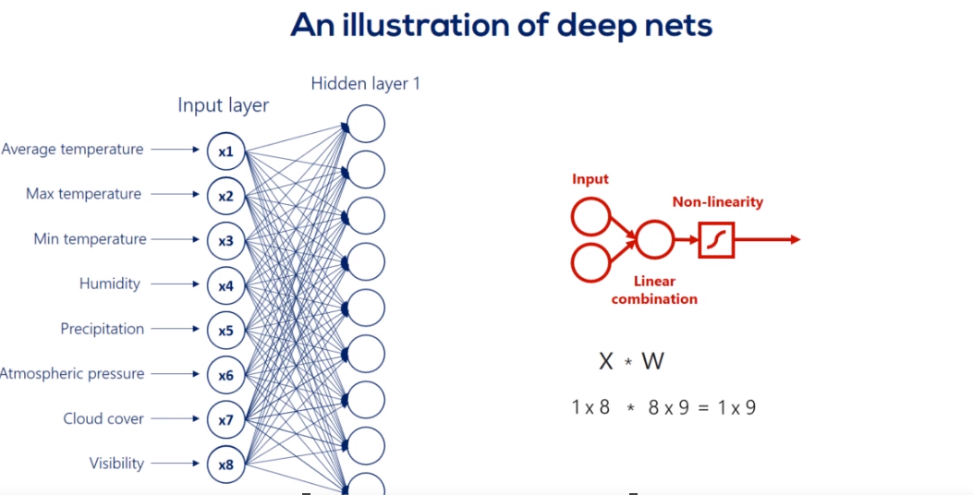
deep

Slide 64
Why do we need non-linearlity
H=x*w1
Y=h*w2
y=x*W1*w2
Y=x*w’
Multiple consecutive linear transformations are equivalent to single one

Slide 65
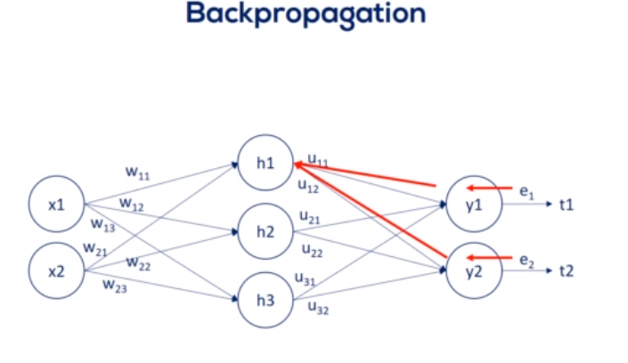
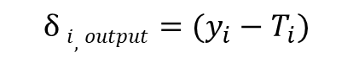
backpropagation
The algorithm adjusts
The weights that have a bigger contributions to the errors by more.
$$δ i,output=(y_{i}−T_{i})$$

